Slide 1
Investigating Algebraic Procedures with Class Discussions and Student Journaling
MNADE Conference October 1, 2010
Jonathan Harper Jeffrey Ford
Minnesota State University, Mankato Minnesota State University, Mankato
jonathan.harper@mnsu.edu jeffrey.ford@mnsu.edu

Slide 2
Intermediate Algebra – Spring 2010
14 sections of 24 students
3 sections used redesigned curriculum
11 sections served as control group
4 days a week
2 days in large lecture with professor
2 days in small group of 24 students with teaching assistant

Slide 3
Framework for Procedural Understanding
Designed to help students develop a deeper, well-connected knowledge of mathematics
Formal Guidelines from NCTM (2001)
Student-centered Questions (Hasenbank, 2006)

Slide 4
Writing in Mathematics
AMATYC and MAA advocate incorporation of writing in mathematics but not widely implemented
Feasibility fears (Seto & Meel, 2006)
Students asked to explain their thinking in response to prompts from the Framework
Tool to strengthen and evaluate understanding (Goos, 2004)

Slide 5
Framework Goal 1
The student understands the overall goal of the algebraic process and knows how to predict or estimate the outcome.
1(a) What is the goal of the procedure?
1(b) What sort of answer should I expect?

Slide 6
Framework Goal 2
The student understands how to carry out an algebraic process and knows alternative methods and representations of the process.
2(a) How do I execute the procedure?
2(b) What are some other procedures I could use instead?

Slide 7
Framework Goal 3
The student understands and can communicate to others why the process is effective and leads to valid results.
Why is the procedure effective and valid?

Slide 8
Framework Goal 4
The student understands how to evaluate the results of an algebraic process by invoking connections with a context or with other mathematics the student knows.
What connections or contextual features could I use to verify my answer?

Slide 9
Framework Goal 5
The student understands and uses mathematical reasoning to assess the relative efficiency and accuracy of an algebraic process compared with alternative methods that might have been used.
When is this the “best” procedure to use?

Slide 10
Framework Goal 6
The student understands why an algebraic process empowers her or him as a mathematical problem solver.
What can I use this procedure to do?

Slide 11
Treatment Curriculum
Students attended same lectures as control group
Small group instructor used different activities and lesson plans
Discussion oriented, technology use
Students had regular writing prompts in small group class
Students wrote different quizzes during the semester

Slide 12
Lesson Plans
See handout for discussion

Slide 13
Writing Prompts – In Class
Explain why we graph functions.
Explain the differences between the solution to a linear equation and a linear inequality.
Explain why we can drop the absolute value bars by setting the equation to the positive and negative values of the constant.
Explain why factoring quadratic equations is an effective and valid procedure for obtaining a solution

Slide 14
Writing Prompts – Quizzes
Tanner solved a system of linear equations and found the solution was (-4, 1). What does this answer tell Tanner about the graphs of the two equations? Explain why.
A classmate simplified the expression and thinks that the answer is . Show your classmate how to verify this without using the formula, since that would just duplicate your classmate’s work.

Slide 15
Writing Prompts – Quizzes
Nick is excited that he knows how to check his answers, but he is worried that he might miss a solution because some absolute value equations have two solutions. Explain either in words of with examples how you know when an absolute value equation has 0, 1, or 2 solutions.

Slide 16
Instructor Experience
Students felt rushed by trying to fit in all 6 goals in a 50 minute class period.
Using technology to graphically demonstrate concepts was very helpful.
Students typically needed to complete 3-5 writing prompts before understanding the concept of how to complete the prompts.

Slide 17
Students’ Perspectives
“I did not like math at all before I took this class and now I even can say that I can do math and like it.”
“I really did not enjoy the lengthy word answers on the quizzes.”
“The quizzes don’t cover material, I don’t feel you should have to write out answers… it’s math, you’re supposed to calculate, not write a paper.”

Slide 18
Assessment
Pretest and posttest given to all sections to evaluate procedural execution skills
All sections given a writing exam at the end of the semester to evaluate procedural understanding as defined by Framework goals

Slide 19
Pre-Post Findings
Treatment students scored lower on the skills pretest with a statistically significant difference compared to the mean of the control group
Treatment student scored comparable to control groups on the posttest
Insert color profile plot

Slide 20
Framework Understanding Findings
Significant correlation between performance on final exam and the Framework writing exam
r = .646, p < .001
Significant difference between treatment and control group means on the Framework exam
t = 3.219, p = .002
Mean difference of 3.398
Moderate effect size: Cohen’s d = .484

Slide 21

Sample Questions & Responses Framework Goal 1
Adam is reviewing for the final exam and has
come to the exponent sections. He is working
on the following problem and worked a few
steps:
Adam is correct so far but wonders how much further he
needs to go. Help him review the criteria for when an
exponent expression is considered fully simplified.

Slide 22
High-level response:
This is not fully simplified. You can not have negative exponents, the “y’s” can be combined and need to make sure the numbers coefficients cannot be reduced any further.
Low-level response:
He needs to multiply by 16 and 9 for the top and bottom.

Slide 23
Framework Goal 2
Show Josh how to factor the above polynomial
using a more systematic method rather than
just guess and check.
The previous question asked the student to
check an incorrect factorization of the following
polynomial:
15x² + 17x - 4

Slide 24
High-level response:
SCAN 019
Low-level response:
(x + 6)(x – 6)

Slide 25
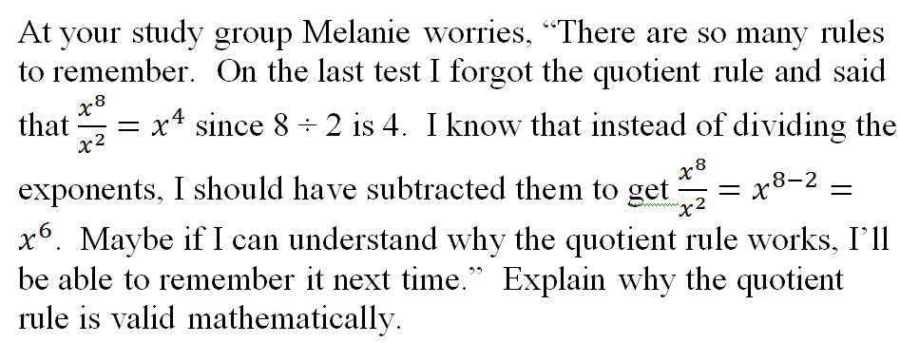
Framework Goal 3

Slide 26
High-level response:
Student showed 8 factors of x in the numerator and 2 factors of x in the denominator. The canceling was shown to give 6 remaining factors on top.
Low-level response:
The quotient rule is valid mathematically because there is factoring involved.

Slide 27
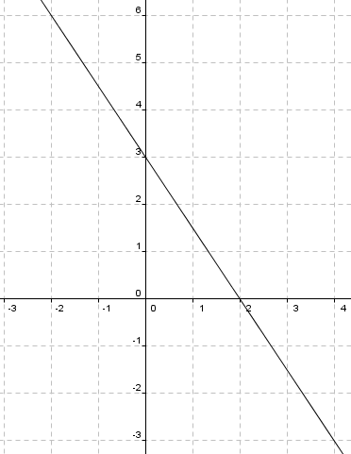
Framework Goal 4
Jeff claims that he has graphed 3x + 2y = 6
(shown below). How can you verify that his
graph is correct?

Slide 28
High-level response:
SCAN 019
Low-level response:
I cannot remember, however, counting the lines from left to right -9/6 or -6/9 would be the slope which means that the slope would be negative.

Slide 29
Questions/Discussion

